Slide 1
Welcome
RAJSHREE INDUSTRIES
(An ISO 9001:2008 Certified Company)
COMPANY PROFILE

Slide 2
Know Us
It is the quality and performance of the products that differentiate a good company from the bad one. Better the quality and more efficient the performance of products, the company will be more credible in the industry. On the basis of this fact, Rajshree Industries with its highly qualified engineers and competent has made a respectable place in the industry.
Rajshree Industries has given extreme emphasis on producing the highest quality parts. The company is manufacturer of sheet metal parts, auto components, high pressure hoses, fuel lines/pipes being as an OEM’s to various manufacturer of Excavators, Dumpers, Earth movers, Cranes, Railway Equipments, Automobile & Generator parts since our inception in 1984.
We are OEM’s to various companies such as Honda Siel Power Products, Escorts Ltd., JCB India Ltd., Knorr-Bremse, SKH M&M, Caparo to name a few.
As one of the prestigious manufacturers of the aforesaid products, we have acquired the reputation of a one-stop shop for all types of custom tools. We possess all the resources and facilities to offer customized solutions to our customers. The quality standard as well as customized products is assured to be as per the ISO 9001 certified quality systems. The certification has been provided to us by ISO 9001:2008 by KBS Certifications.

Slide 3
Q
Quality Policy & Objectives
We are committed to customer satisfaction by meeting
their requirements and to pursue the program of continuous
improvements
To enhance customer satisfaction level >95%
Timely Delivery against orders
To minimize customer rejection <0.5%
To reduce internal rejection <1%

Slide 4
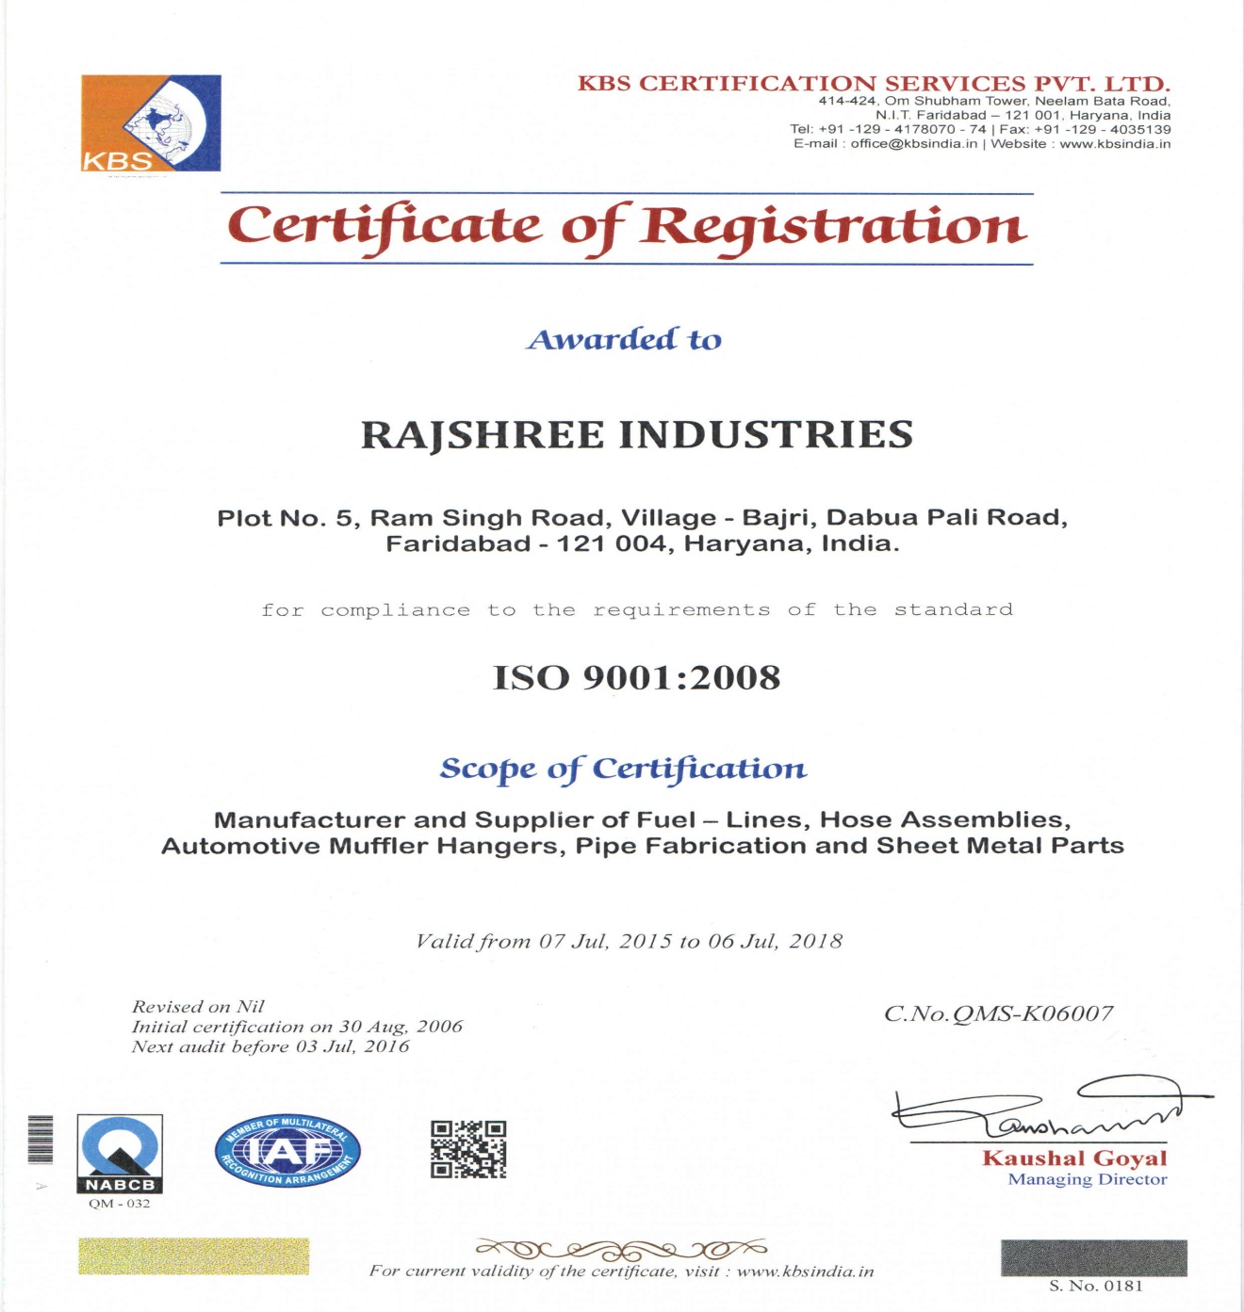
Certification

Slide 5
Our Valued Stakeholders

Slide 6
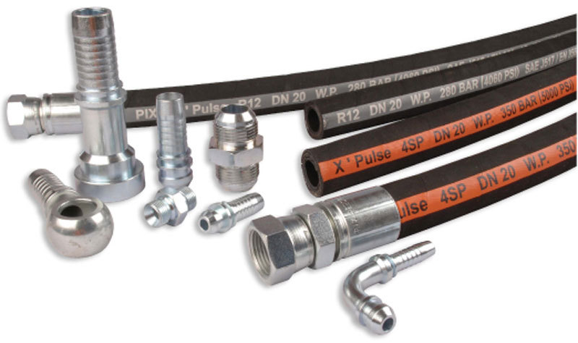
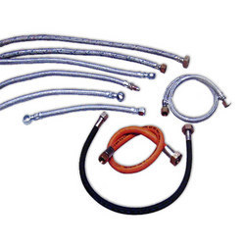
Products, We Offer
High Pressure Hoses Assy. For
Railway Equipments
Flexible Hoses Assy.
For Railways

Slide 7
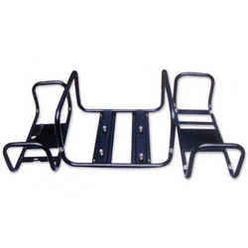
Products, We Offer
Pipe Frame Assy. For
Gen. Set
Frame Assemblies for Gen. Set

Slide 8
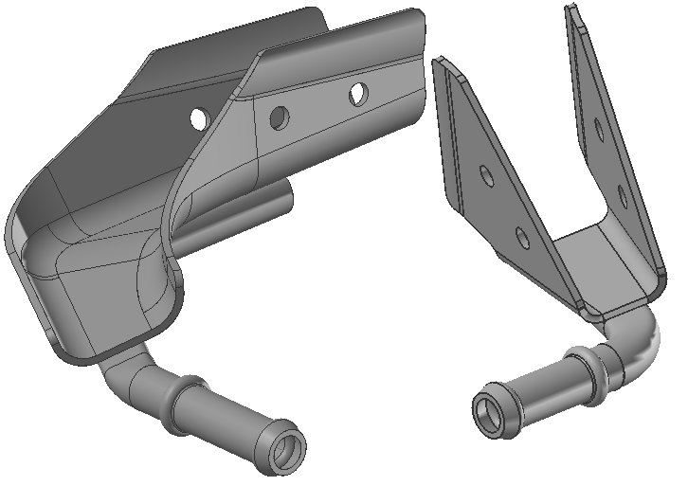
Products, We Offer
Automotive Hangers Assemblies
For 4 Wheelers
Automotive Hangers Assemblies
For 4 Wheelers

Slide 9
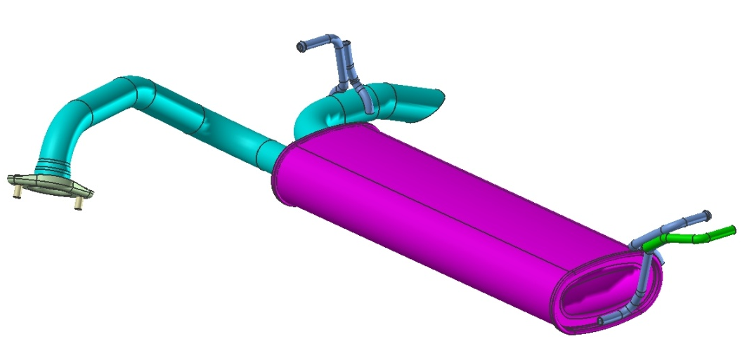
Products, We Offer
Pipe Hanger for 4 Wheelers

Slide 10
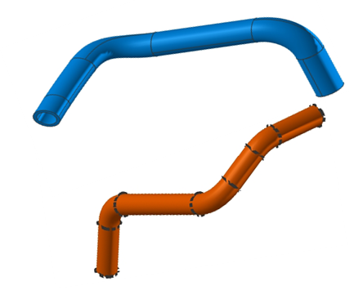
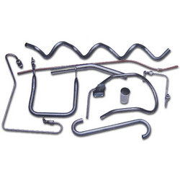
Products, We Offer
Pipe Hanger for 4 Wheelers
Fuel Lines

Slide 11
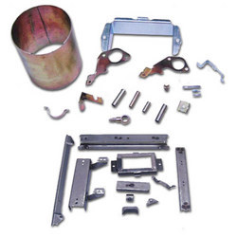
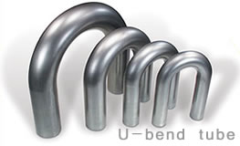
Products, We Offer
Sheet Metal Parts
U-Bend Tubes

Slide 12
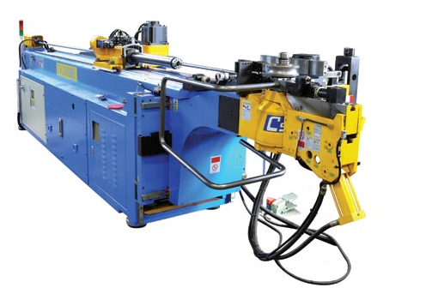
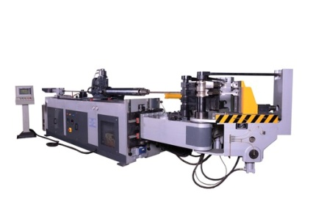
Manufacturing Capability
3 Axis CNC
Tube Bending M/c
Made in Taiwan
5 Axis CNC
Tube Bending M/c

Slide 13
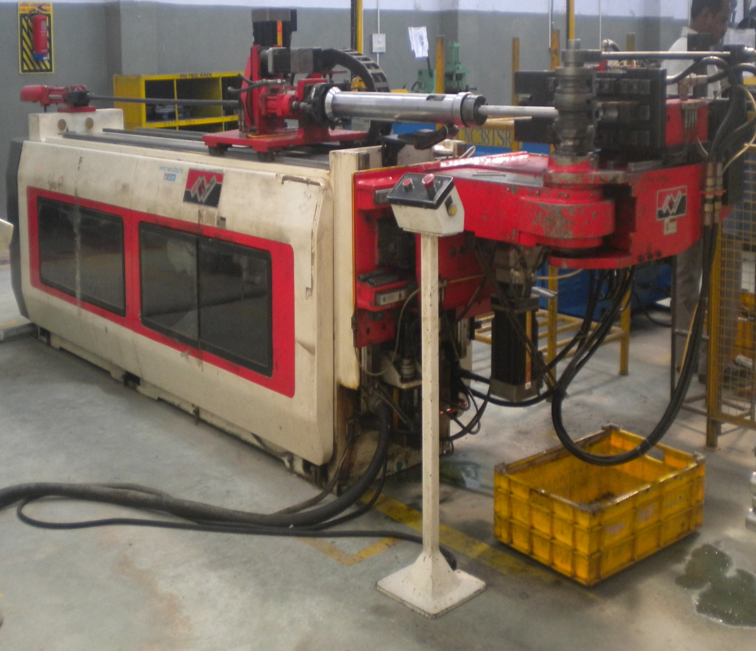
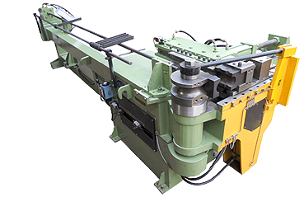
Manufacturing Capability
3 Axis CNC
Tube Bending M/c
5 Axis CNC
Tube Bending M/c

Slide 14
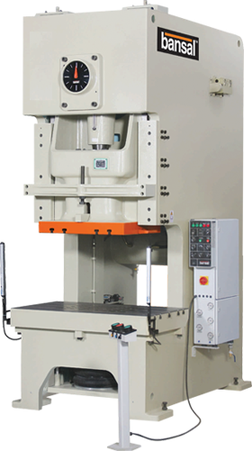
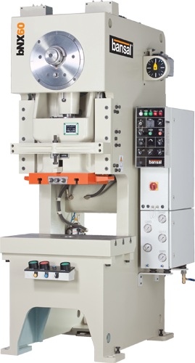
Manufacturing Capability
bNX160
Mech./ Hyd./ Pneumatic POWER PRESSES
10 TON to 160 TON
Qty. - 11 Nos.

Slide 15
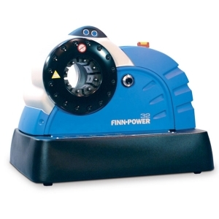
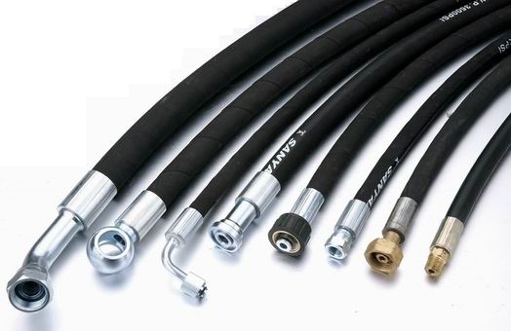
Manufacturing Capability
Hose Crimping CNC M/c

Slide 16
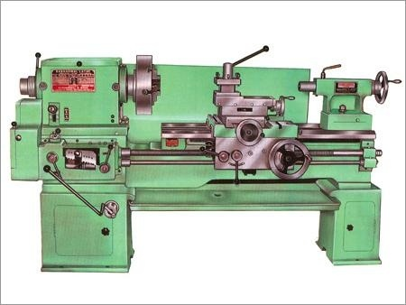
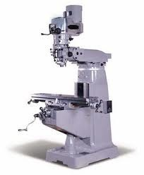
Manufacturing Capability
Tool Room Facility
Milling Machine - 01 Nos.
Lathe Machine - 03 Nos.
Surface Grinder - 05 Nos.
Drill Machine - 03 Nos.
Lathe Adda - 03 Nos.

Slide 17
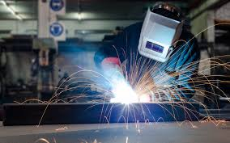
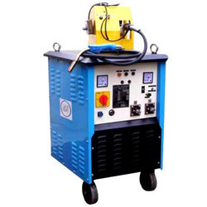
Manufacturing Capability
Weld shop Facility
Mig Welding M/c (250Amp. To 400Amp.)- 08 Nos.
Arc Welding M/c (400 Amp.) - 01 Nos.
Spot & Proj. Welding M/c (75 Kva) - 01 Nos.

Slide 18
Contact Us
Address : Plot No. 5, Ram Singh Road,
Vill. –Bajri, Dabua-Pali Road,
N.I.T. Faridabad, Haryana, 121001
Tel./ FAX : (O) +91-129- 2481951, 3294433
(M) +91-9810053587
(R) +91-0129-2427884
E-mail : info@rajshreeindustries.com
mktg@rajshreeindustries.com
Visit us at : www.rajshreeindustries.com
www.indiamart/rajshreeindustries

Slide 19
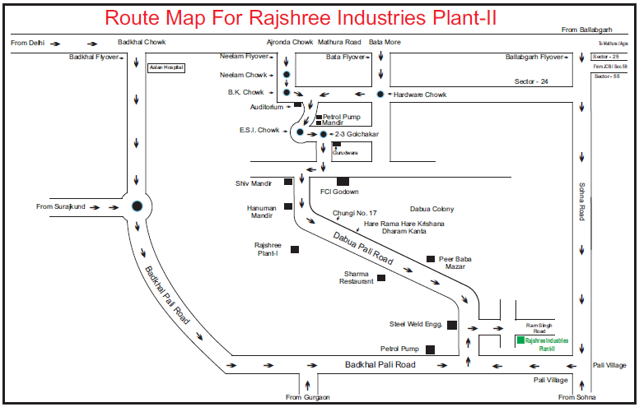
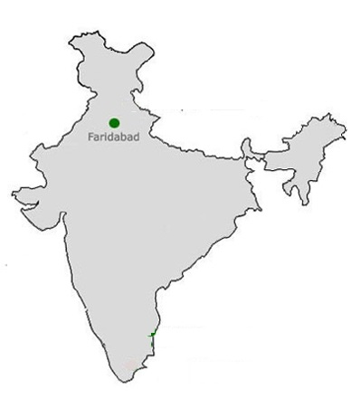
Route map

Slide 20
Rajshree industries
Please give us a chance to serve you.
Thanking You…

